Slide 1
Disclaimer
All similarities between TRAVELclique and other legal entities, companies, ventures or individuals either based in the United Kingdom or other countries contained within this material is purely coincidental.
This content and associated products or services (“materials”), are provided “as is” and without warranties of any kind, whether express or implied. To the fullest extent permissible pursuant to applicable law, Lee Cowdrey disclaims all warranties, express or implied, including, but not limited to, implied warranties of merchantability and fitness for a particular purpose, title, non- infringement, freedom from computer virus, and warranties arising from course of dealing or course of performance. Lee cowdrey represent or warrant that the functions described or contained in the materials will be uninterrupted or error-free, that defects will be corrected, or are free of viruses or other harmful components. No warranties or representations are made regarding the use of the materials in terms of their completeness, correctness, accuracy, adequacy, usefulness, timeliness, reliability, or otherwise. As a condition of your use of the materials, you warrant to not make use thereof for any purpose that is unlawful or prohibited by their associated terms of use.
All trademarks identified by ™ or ® are trademarks or registered trademarks and copyrights identified by © in the United Kingdom may be registered in other countries.
All product names, trademarks, registered trademarks and copyrights are the property of their respective owners.

Slide 2
TRAVELclique
Optimisation and Enhancement

Slide 3







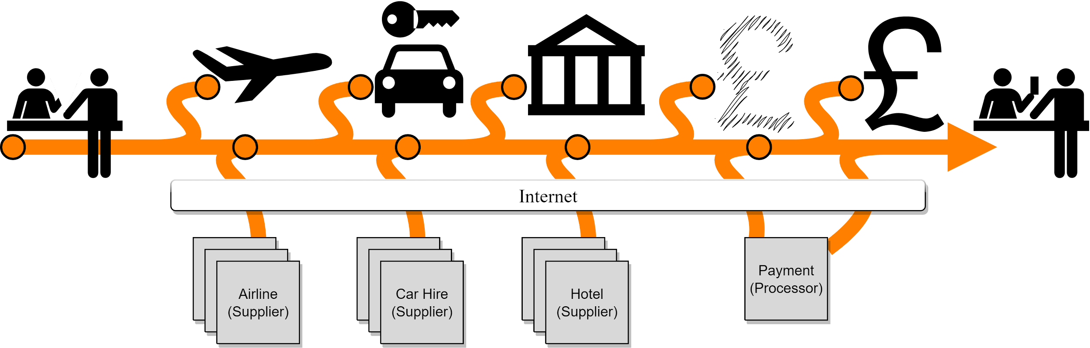
Today
Issues seen include:
Delays with client accepting each package item including cause reservation expiration
Availability Change
Price Change
Withdrawn
Overbooked
Terms & Conditions not met
Balance not paid in time (deposit)
Payment Issues (processor failure)
Payment Not Authorised
TRAVELclique losing 10% time per package booking just by swivel-chair operation
Limited ability to upsell additional package items (insurance, upgrades, airport lounges etc.)
Issues cause entire process to be restarted, with potentially all existing remaining valid reservations cancelled or client just withdrawing without purchasing anything !
TRAVELclique
Client
TRAVELclique identifies accommodation and reserves
Client presents holiday package wishes
TRAVELclique identifies flight and reserves
optional, Client pays deposit
TRAVELclique identifies vehicle hire and reserves
Client pays outstanding balance
TRAVELclique confirms all reservations and proceeds to ticketing

Slide 4
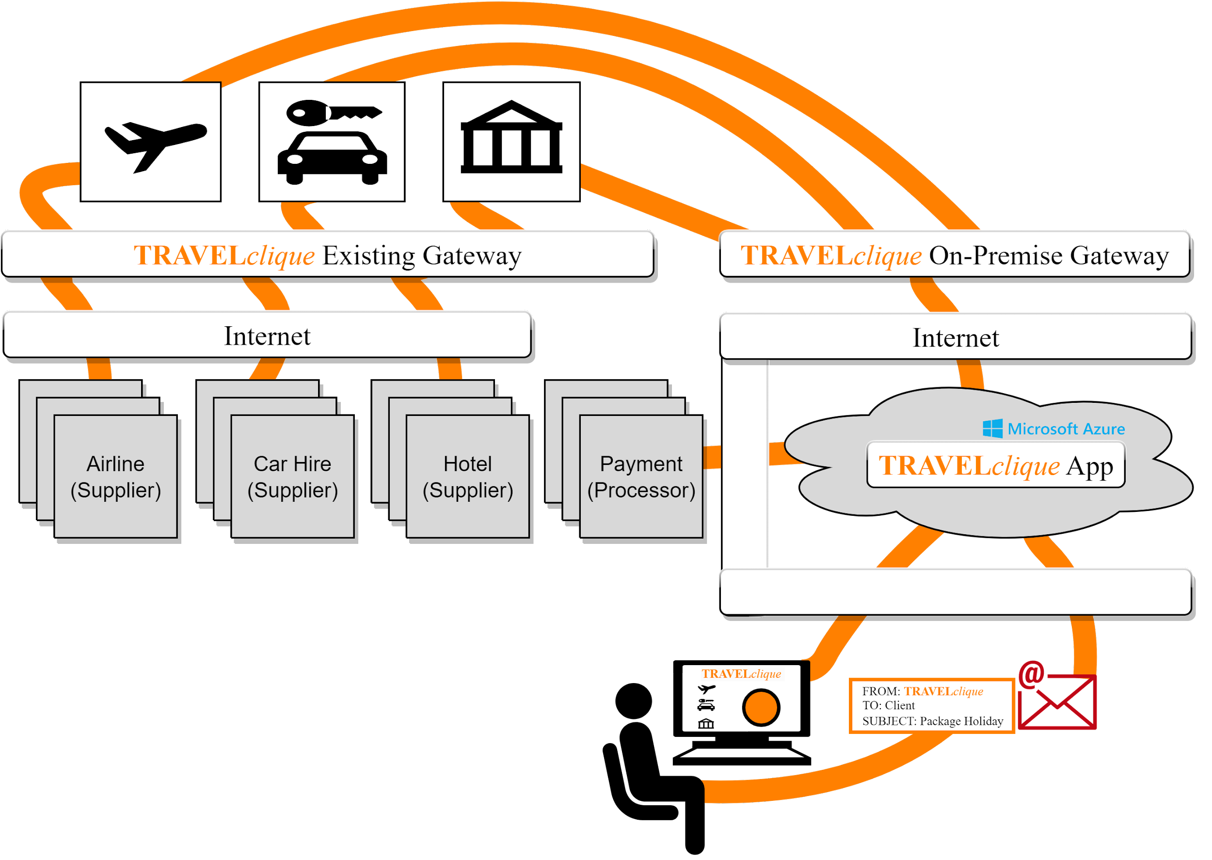
Tomorrow
Client searches for holiday package wishes via TRAVELclique App hosted in public cloud
TRAVELclique App mixes flight, vehicle, accommodation, connects back to on-site systems for availability etc.
Client makes final selection and confirms on TRAVELclique App
TRAVELclique App changes reservations to confirmations and retrieves booking details
TRAVELclique App allows Client to checkout and takes payment (deposit, full, payment plan etc.)
TRAVELclique confirms all reservations and proceeds to ticketing

Slide 5
TRAVELclique App - Infrastructure
Benefits
Deployed to public cloud avoiding need for dedicated IT facilities
Uses existing systems for Flight, Vehicle and Accomodation
Able to automatically scale to meet demand (on-demand computing)
Up - when demand is high
Down - when no demand/idle
OPEX friendly Pay-Per-Use model, not CAPEX investment
No need to scale in advance
Isolates and protects existing systems from Internet and malicious third-parties
Isolated from outages due to highly available public cloud services
Recommendations
Dedicated Internet connection to public cloud of choice (to ensure availability and response times)
Additional gateway (on-premise)
Public Cloud - Microsoft Azure
Data Centre - Cardiff (UK West)
Data Residency - 100% UK
UK GDPR compliant
Disaster Recovery - London (UK South)
Cross region replication
No restriction on available Azure services

Slide 6
TRAVELclique App - Usability
Search - Tailored
Partial, Wildcard, drop down List for all items
Participating airlines, vehicle hire and accommodation suppliers
Geographic locations including airports, popular/available destinations
Accomodation aspects (single, double etc.)
Vehicle aspects (4x4, SUV etc.)
Minimum/maximum price
Dates ranges
Peak/Off-peak periods
Lists automatically populated from connected systems and used to produce indexes for Partial and Wildcard matching
Payment - Made Easy
Supported number of payment processors can be increased to reduce fees and provide negotiating advantage
Payment processor can be selected based on payment need
Credit supplier specific (AMEX)
Debit supplier specific (Lloyds Merchant)
Loyalty Card reward programmes (Nectar)
Allow Clients to pay through installments using payment plans offered by select payment processors (Payl8r) - TRAVELclique receives full immediate payment (if Client approved)
Allows Clients to form a Savings Plan and purchase the package when the Savings Plan has reached its goal; TRAVELclique App can maintain reserved state (where permitted by suppliers)

Slide 7
TRAVELclique App - Business Benefits
Increased brand recognition
Possibility to extend existing services with impacting current business
Possibility to extend offered services (thus increase revenue)
Insurance
Upgrades (airport lounges)
Foreign currency
TRAVELclique App not just for Client’s using desktop computers but also portable devices (mobile/tablet) to attract and capture the “sofa shoppers”
Through automation and modernisation, TRAVELclique no longer loses 10% time per package booking through swivel-chair operation by adopting a Client Self-Service approach
In-branch staff can also use TRAVELclique App and move to remote-work structure, or consider extended high-street presence by opening new branches without incurring high infrastructure costs
Possibility to expand in to markets outside the United Kingdom

Slide 8




Next Steps
July
August/September
November
Feasibility
Acceptance
Launch
Scope of Works
High Level Design
Formal cost quotation
Work with TRAVELclique to ensure expectations and deliverables match on-going business needs
Launch and promote to UK market before festive session (the traditional period of highly promoted holiday offers)
DevOps
Training
Enterprise Agile approach commences development with short deliveries.
Setup Public Cloud
Where needed, train TRAVELclique customer facing and IT staff on use, operation and administration
August/September
October

Slide 9
Feasibility Study
Workshop with TRAVELclique team
Determine stakeholders for project feasibility, delivery and acceptance
Determine IT Infrastructure availability, capacity and any restrictions
Gather license and API details of existing systems
Gather sample data from existing systems (to be used for data modelling)
Public Cloud
Determine preference (if any)
Determine budgetary details (if any)
Determine type/size of appliance for on-premise gateway
Outcome
Scope of Works for commercial engagement
High Level Design for technical engagement activities
Formal cost quotation with terms and conditions

Slide 10
Expected Resourcing
The team delivering for TRAVELclique (to be confirmed post Feasibility Phase)
1 x Project Manager 1 x Technical Architect
Feasibility Phase Only
1 x Commercial Specialist 1 x Legal Specialist 1 x Business Analyst
DevOps/Acceptance Phases Only
1 x DevOps Lead 1 x Azure Engineer 2 x Node.js Engineer
2 x Back-End Engineer 2 x QA Engineer 1 x Technical Writer/Trainer
1 x UX Lead 1 x UI Designer 2 x UI Engineer
Launch Phase Only
1 x Marketing Specialist 1 x Advertising Coordinator

Slide 11
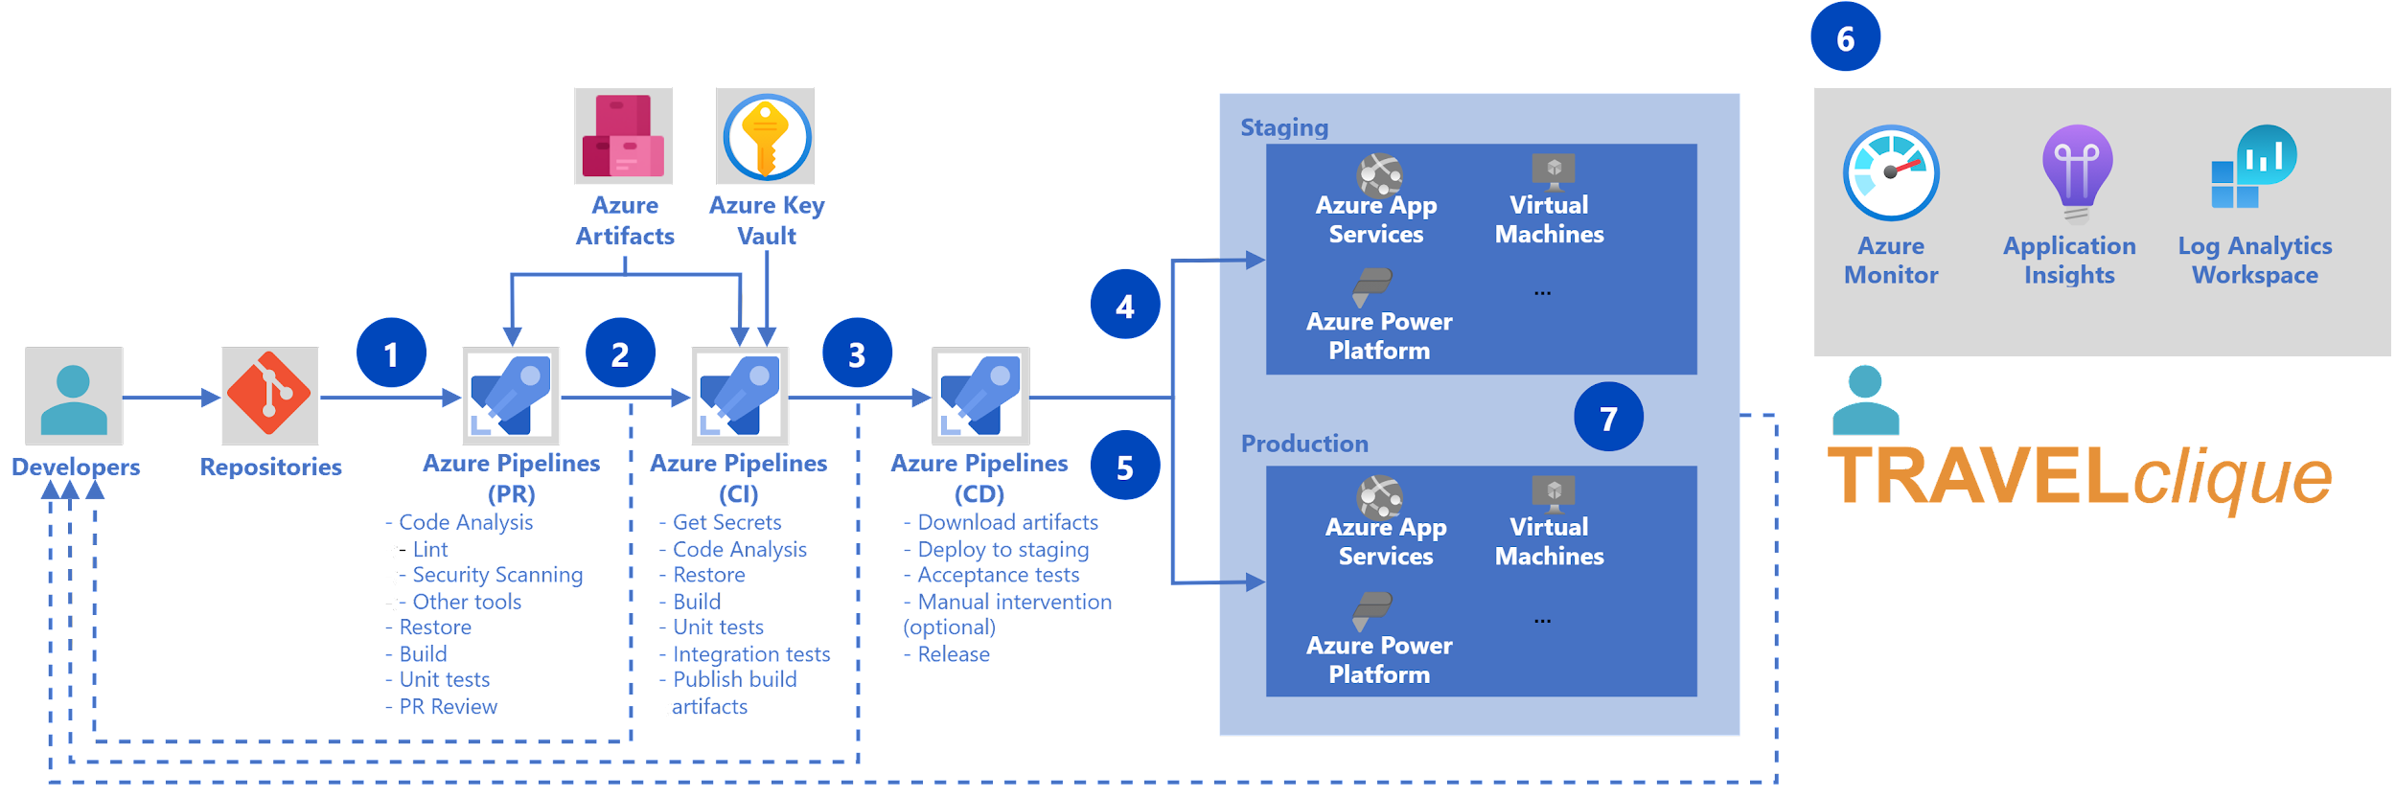
DevOps & Acceptance
Note:
Azure shown for example only; AWS or GCP available based on TRAVELclique requirements
Release to staging + manual 🗹
Developers pushes code changes
Azure repo triggers fast quality check and if no failures will merge the changes
Release to production (on failure, revert to prior)
Run integration checks & if no failures build
Continuous Monitoring of Staging and Production
New iteration now live

Slide 12
TRAVELclique
Thank you for your time !
Any questions?

Slide 13
Not for TRAVELclique
Architecture Slides (draft & incomplete)

Slide 14
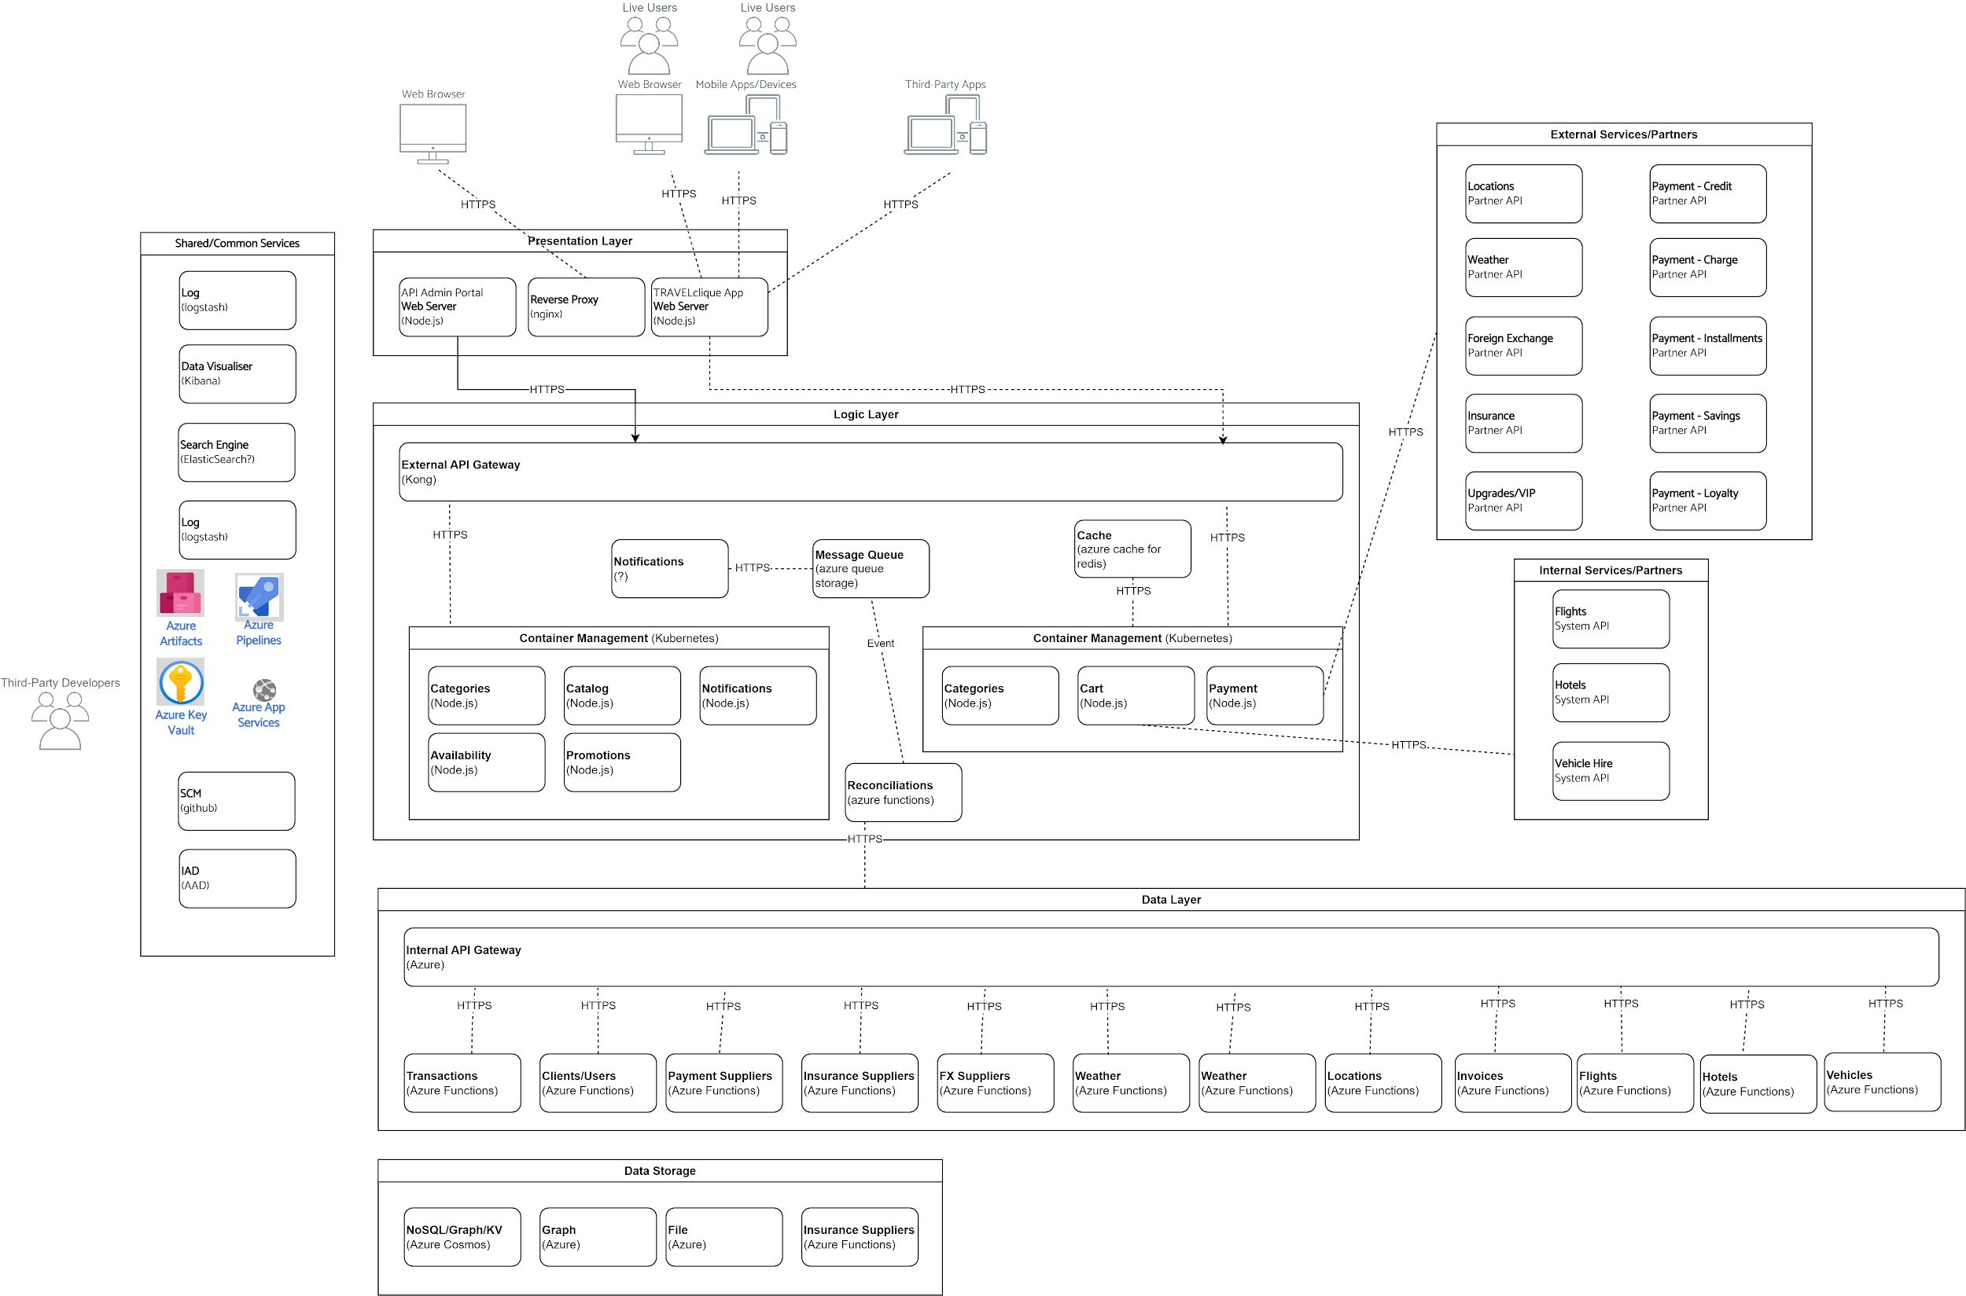
Application & Integration

Slide 15
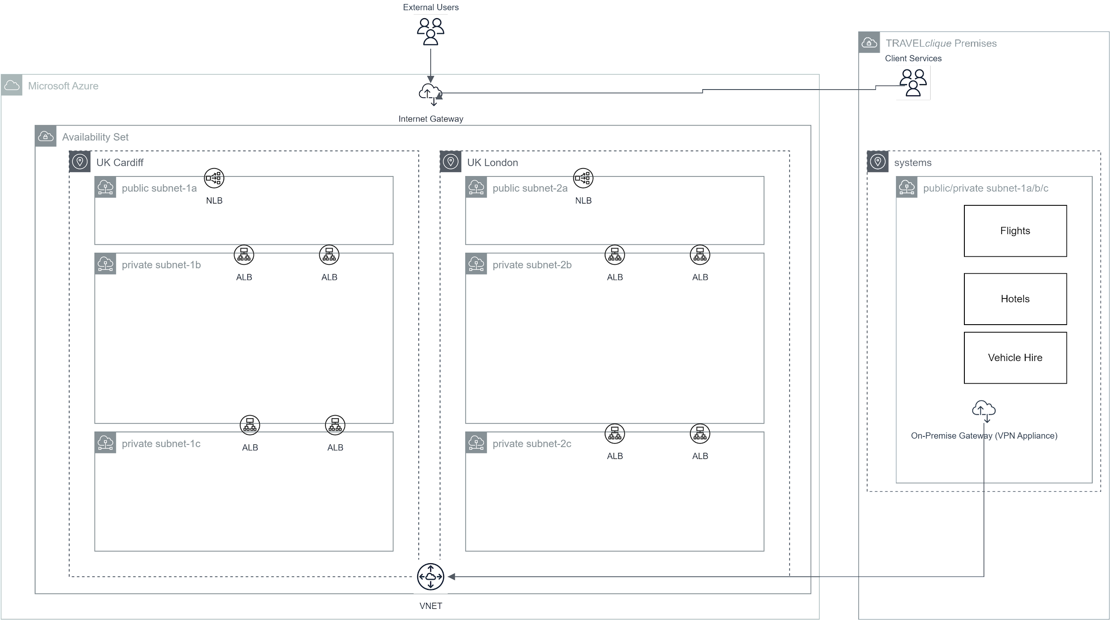
Deployment

